Slide 1

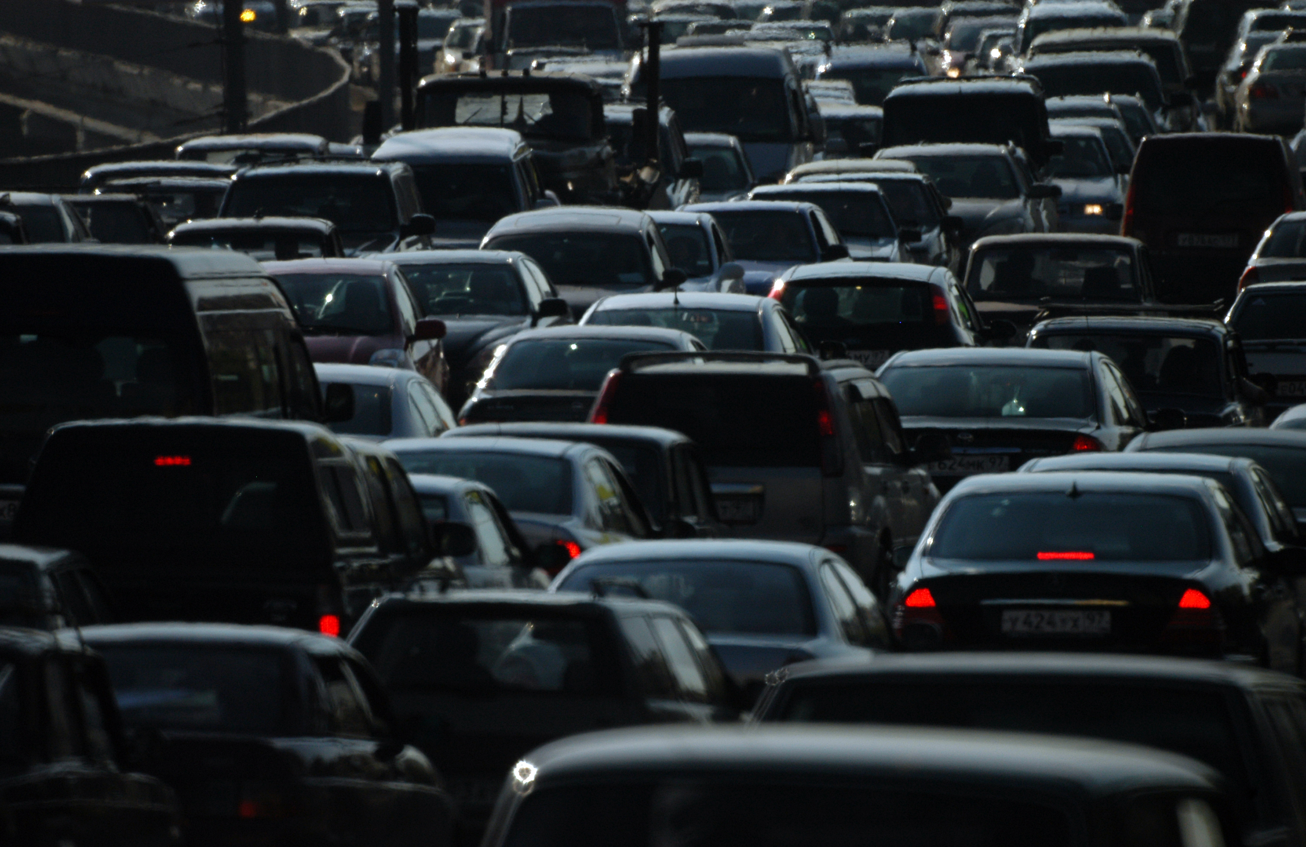


ANALYSISNG THE IMPACT OF CAR FEATURES
View in Power BI
By Sathish
Data Analyst
Bangalore, India
sathishgudri@gmail.com
Last data refresh:
6/12/2024 2:11:16 PM UTC
Downloaded at:
6/12/2024 2:13:51 PM UTC

Slide 2
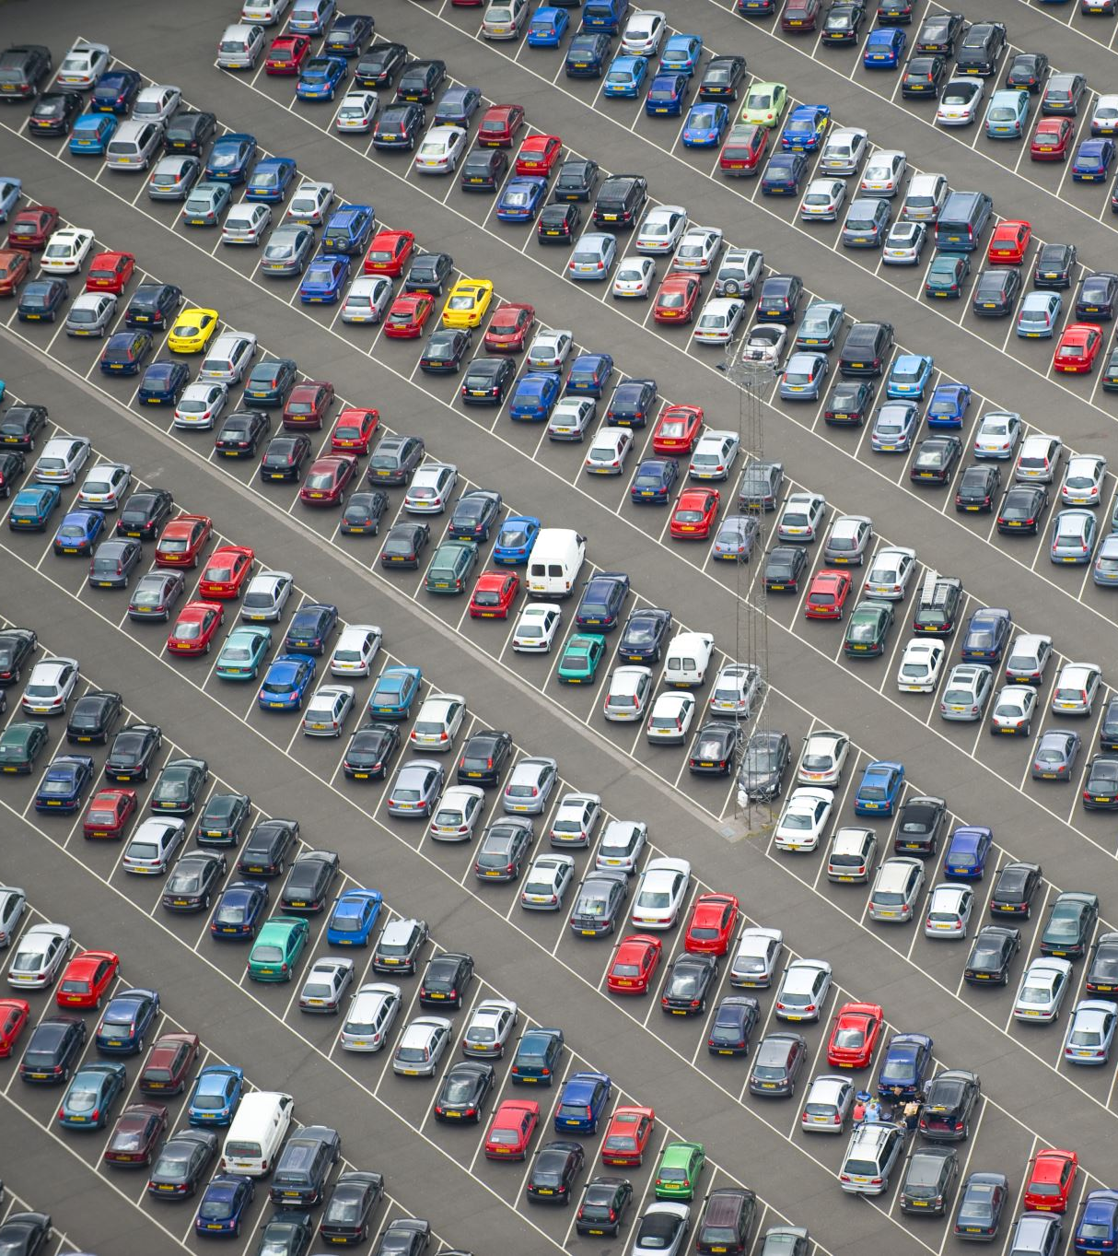
Project Description
The automotive industry has been rapidly evolving over the past few decades, with a growing focus on fuel efficiency, environmental sustainability, and technological innovation. With increasing competition among manufacturers and a changing consumer landscape, it has become more important than ever to understand the factors that drive consumer demand for cars.
The client has asked How can a car manufacturer optimize pricing and product development decisions to maximize profitability while meeting consumer demand?

Slide 3

Approach
This problem could be approached by analyzing the relationship between a car's features, market category, and pricing, and identifying which features and categories are most popular among consumers and most profitable for the manufacturer.

Slide 4
Tech Stacks Used
Microsoft Excel
Data Cleaning & Wrangling
Microsoft Power BI
Data Analysis and Visualization
Microsoft PowerPoint
Insight Presentation

Slide 5
Brand Analysis
Understanding the popularity based on the Brand

Slide 6
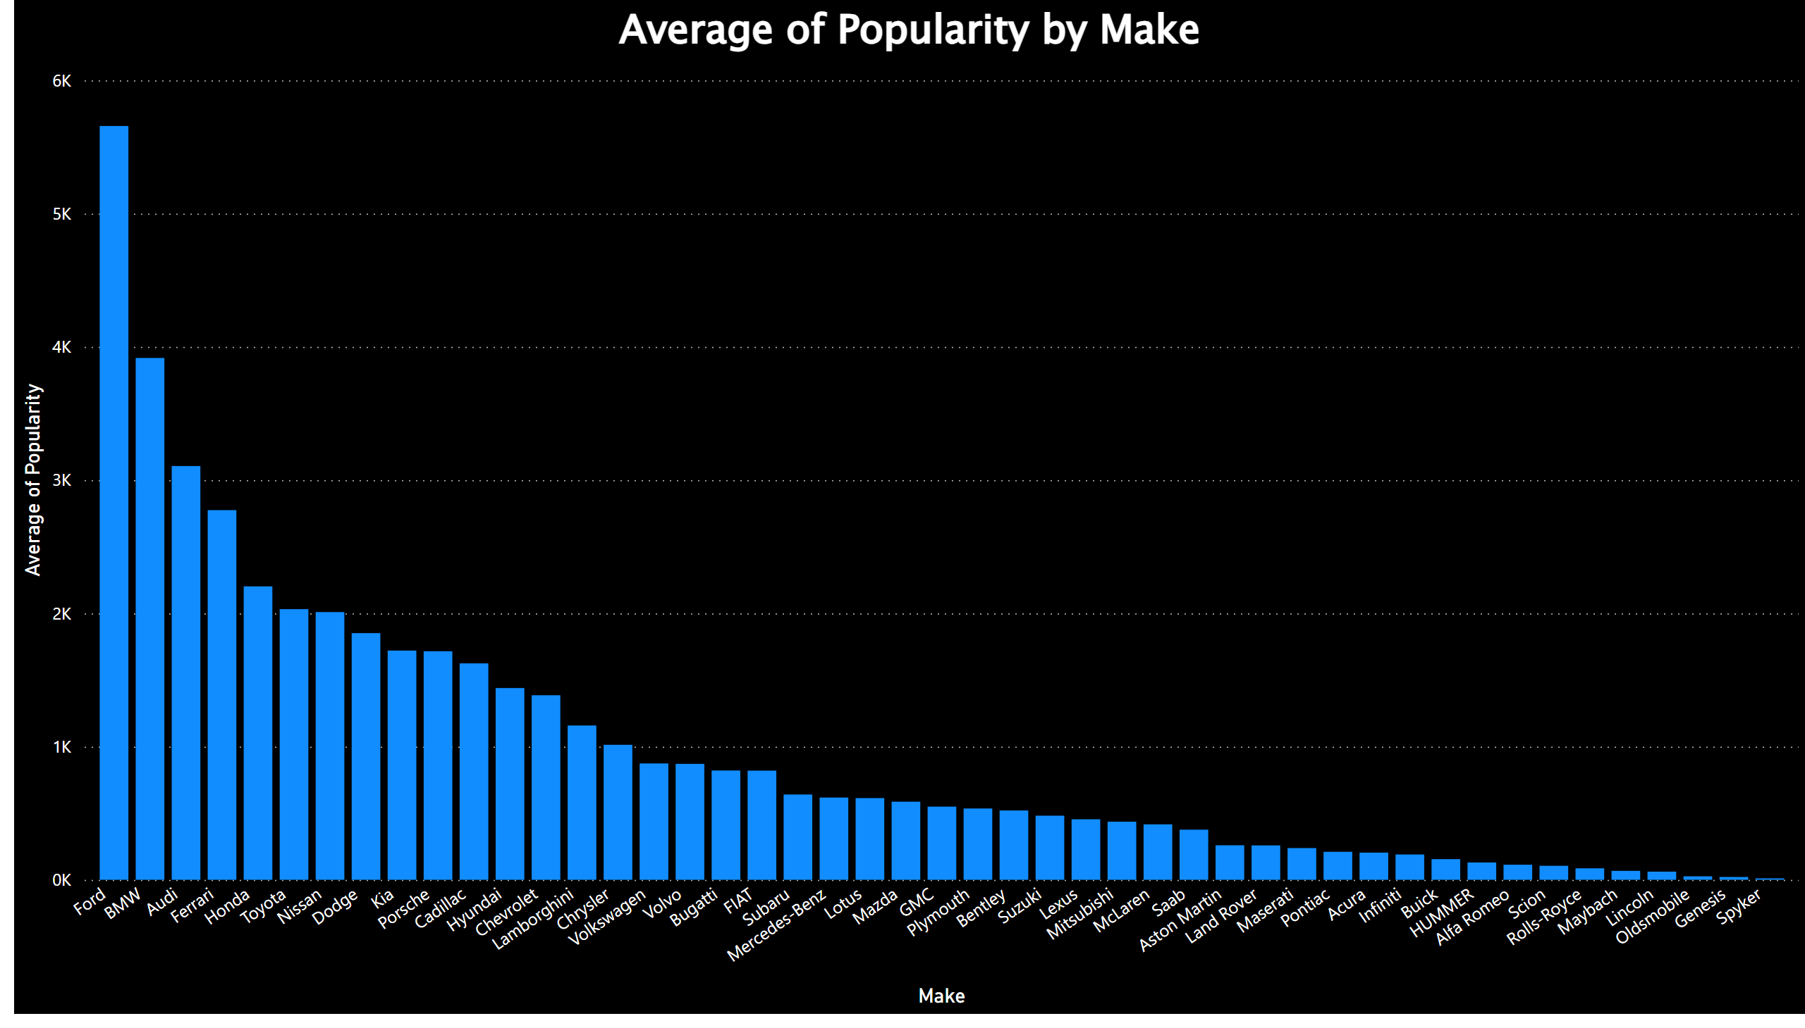
Popular Brand Analysis
Brand Analysis reveals that,
‘Ford’, ‘BMW’, and ‘Audi’ are most popular brands based on the mean popularity.
‘Genesis’ and ‘Spyker’ are the least popular car brands.
Notes:
columnChart
No alt text provided

Slide 7

Fuel Type Analysis
Understanding the popularity based on the Engine Fuel Type

Slide 8
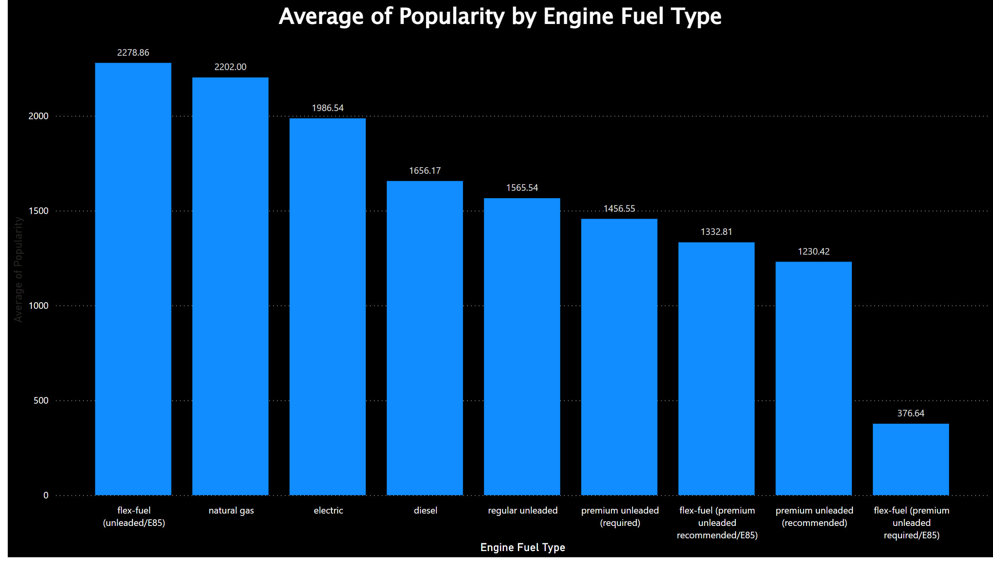
Engine Fuel Type v/s Popularity
Fuel Type Analysis reveals that, ‘flex-fuel (unleaded/E85)’ and ‘natural gas’ are the top most popular fuel types, and ‘flex-fuel (premium unleaded required/E85’ is the least popular.
Notes:
columnChart
No alt text provided

Slide 9
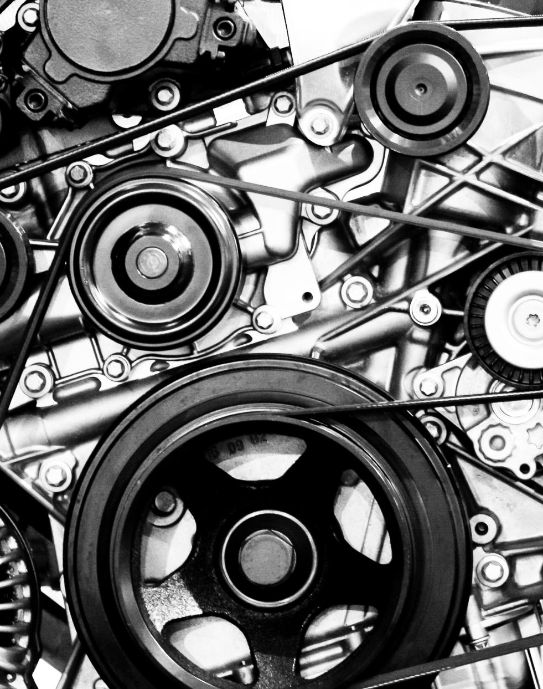
Engine HP Analysis
Understanding the relationship between Engine HP and Popularity

Slide 10
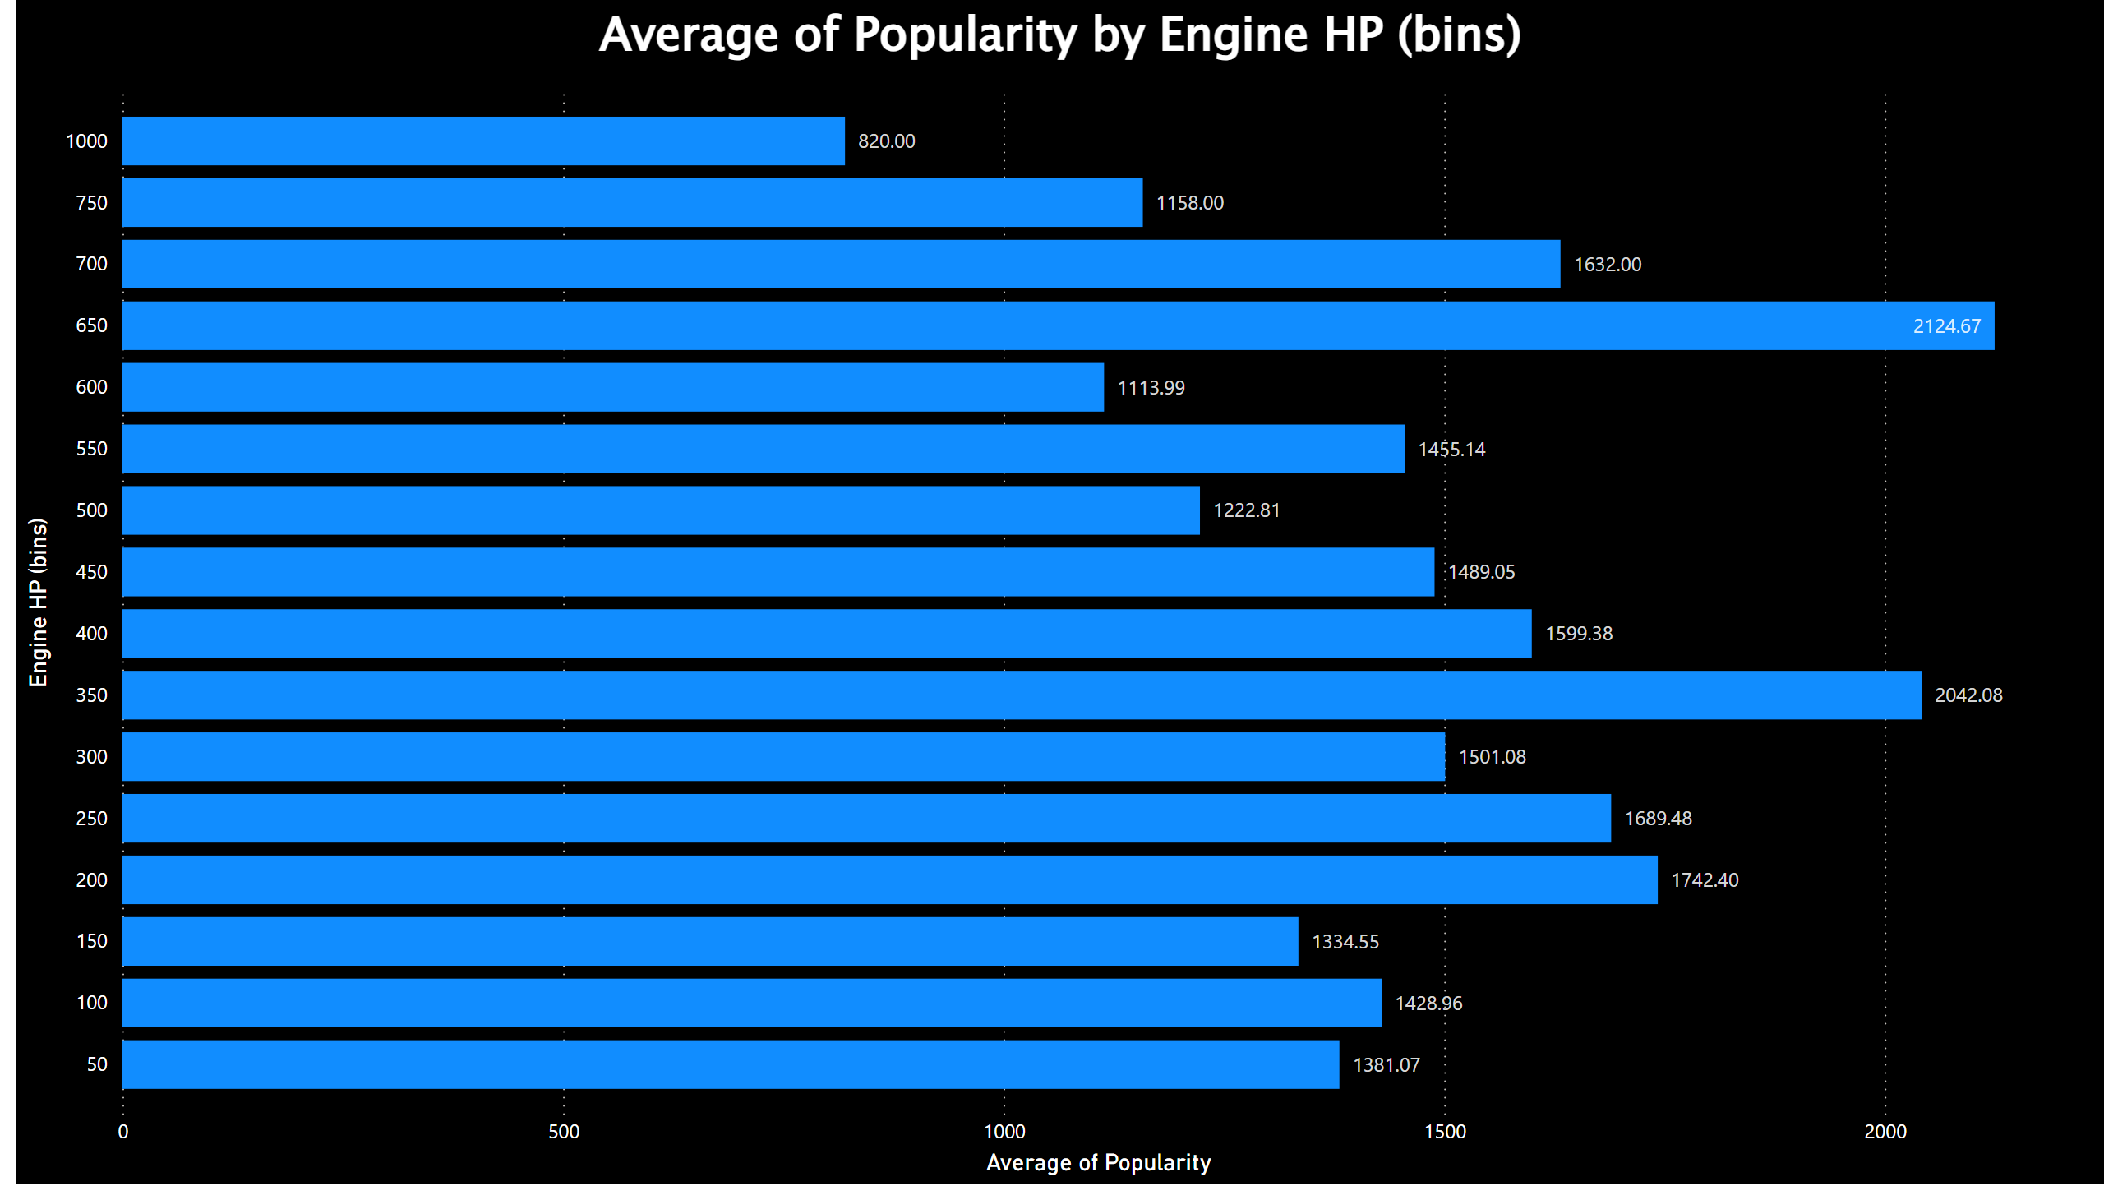
Engine HP v/s Popularity
Notes:
clusteredBarChart
No alt text provided

Slide 11
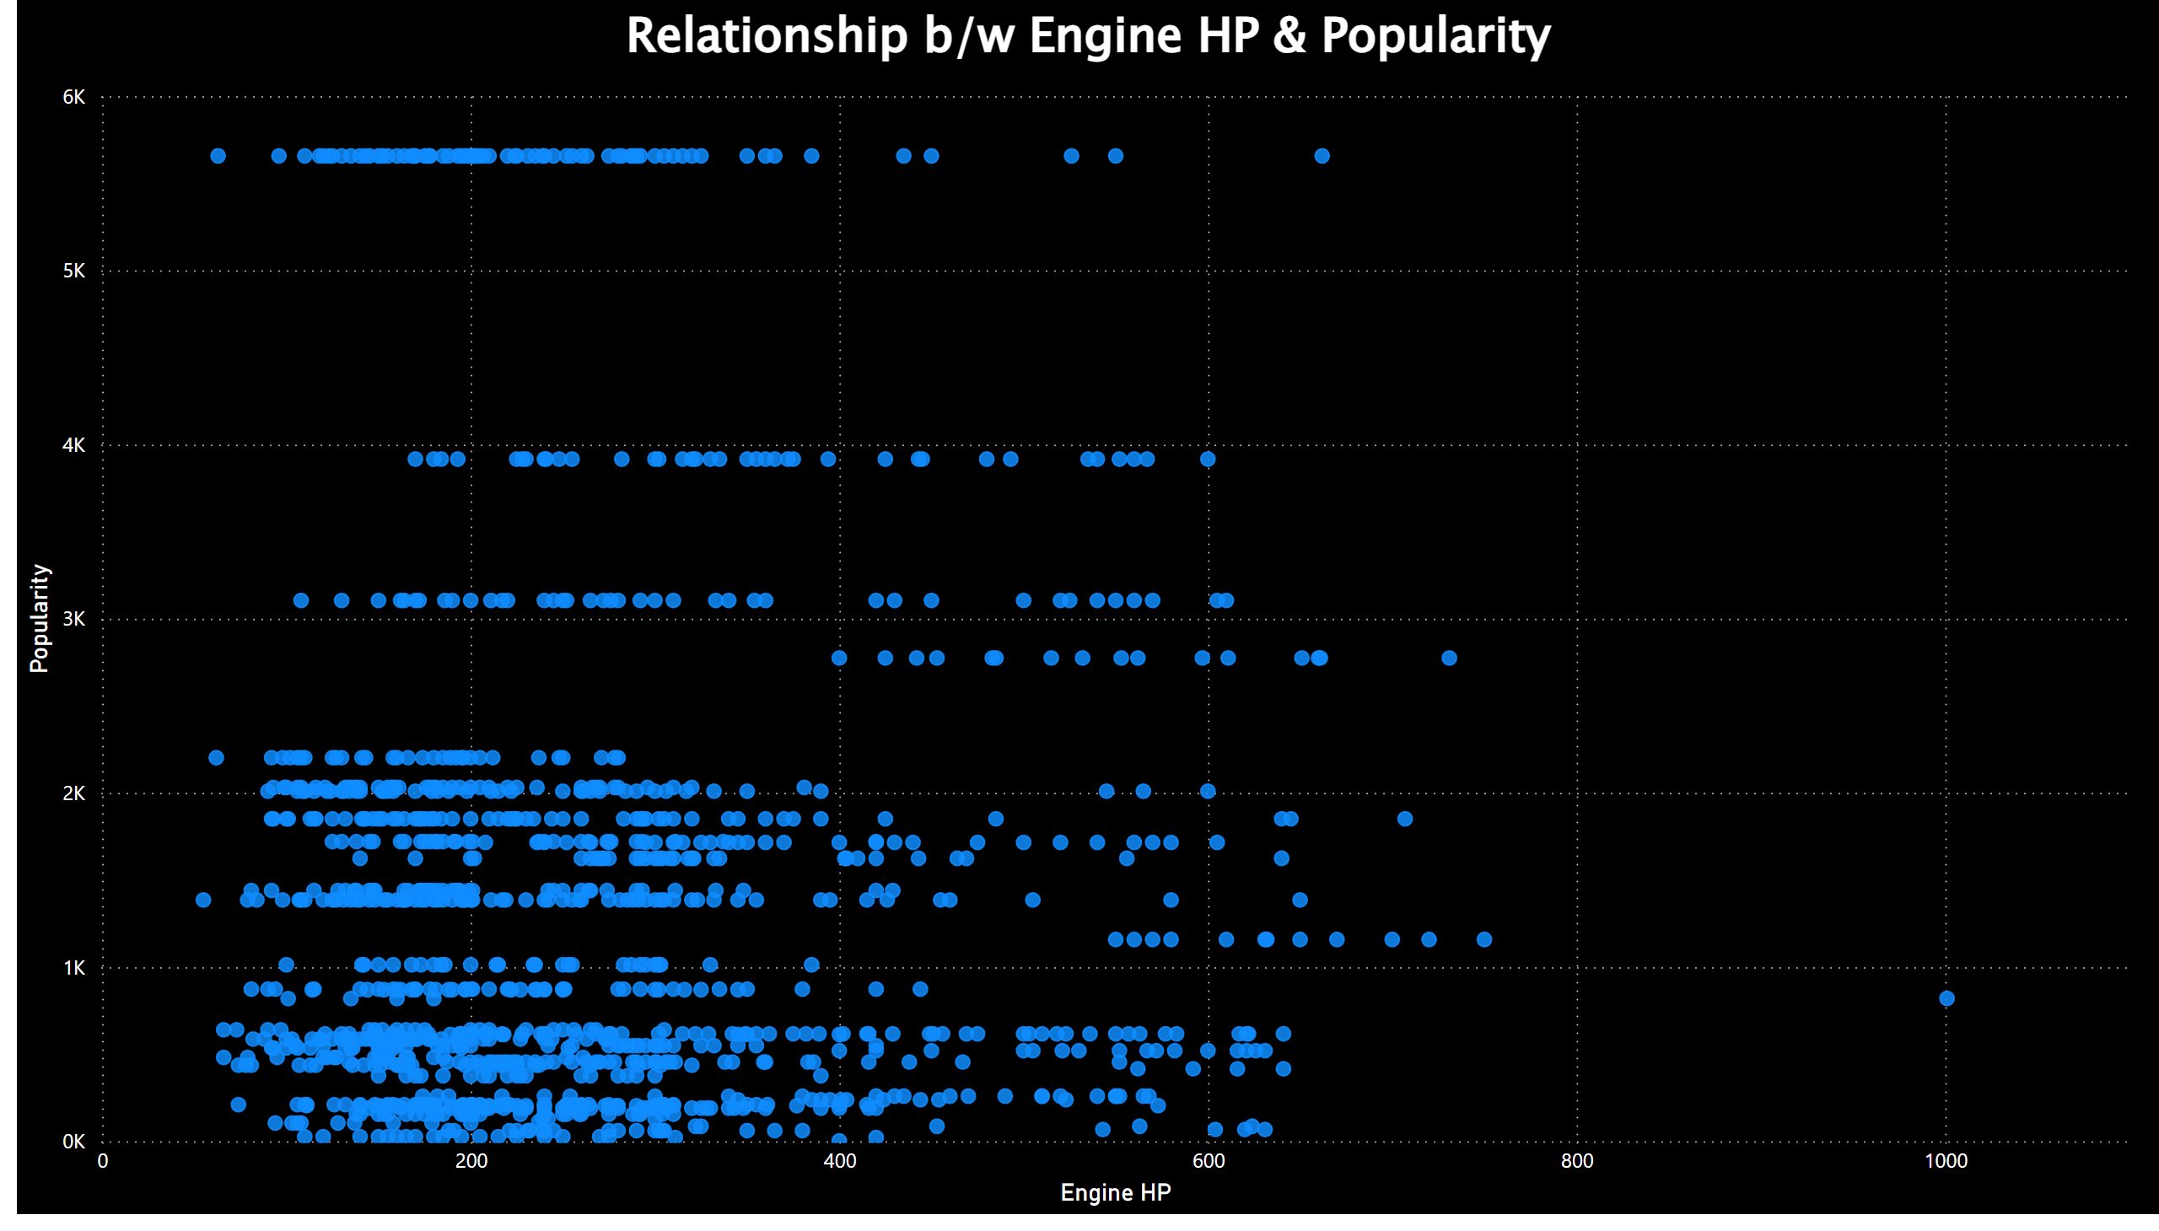
Relationship b/w Engine HP & Popularity
Notes:
Relationship b/w Engine HP & Popularity
No alt text provided

Slide 12
Insigths
Engine HP ranging from 650 to 700 are the most popular followed by HP ranging from 350 to 400.
Scatter plot depicts no direct relationship between the Engine HP and Popularity.

Slide 13
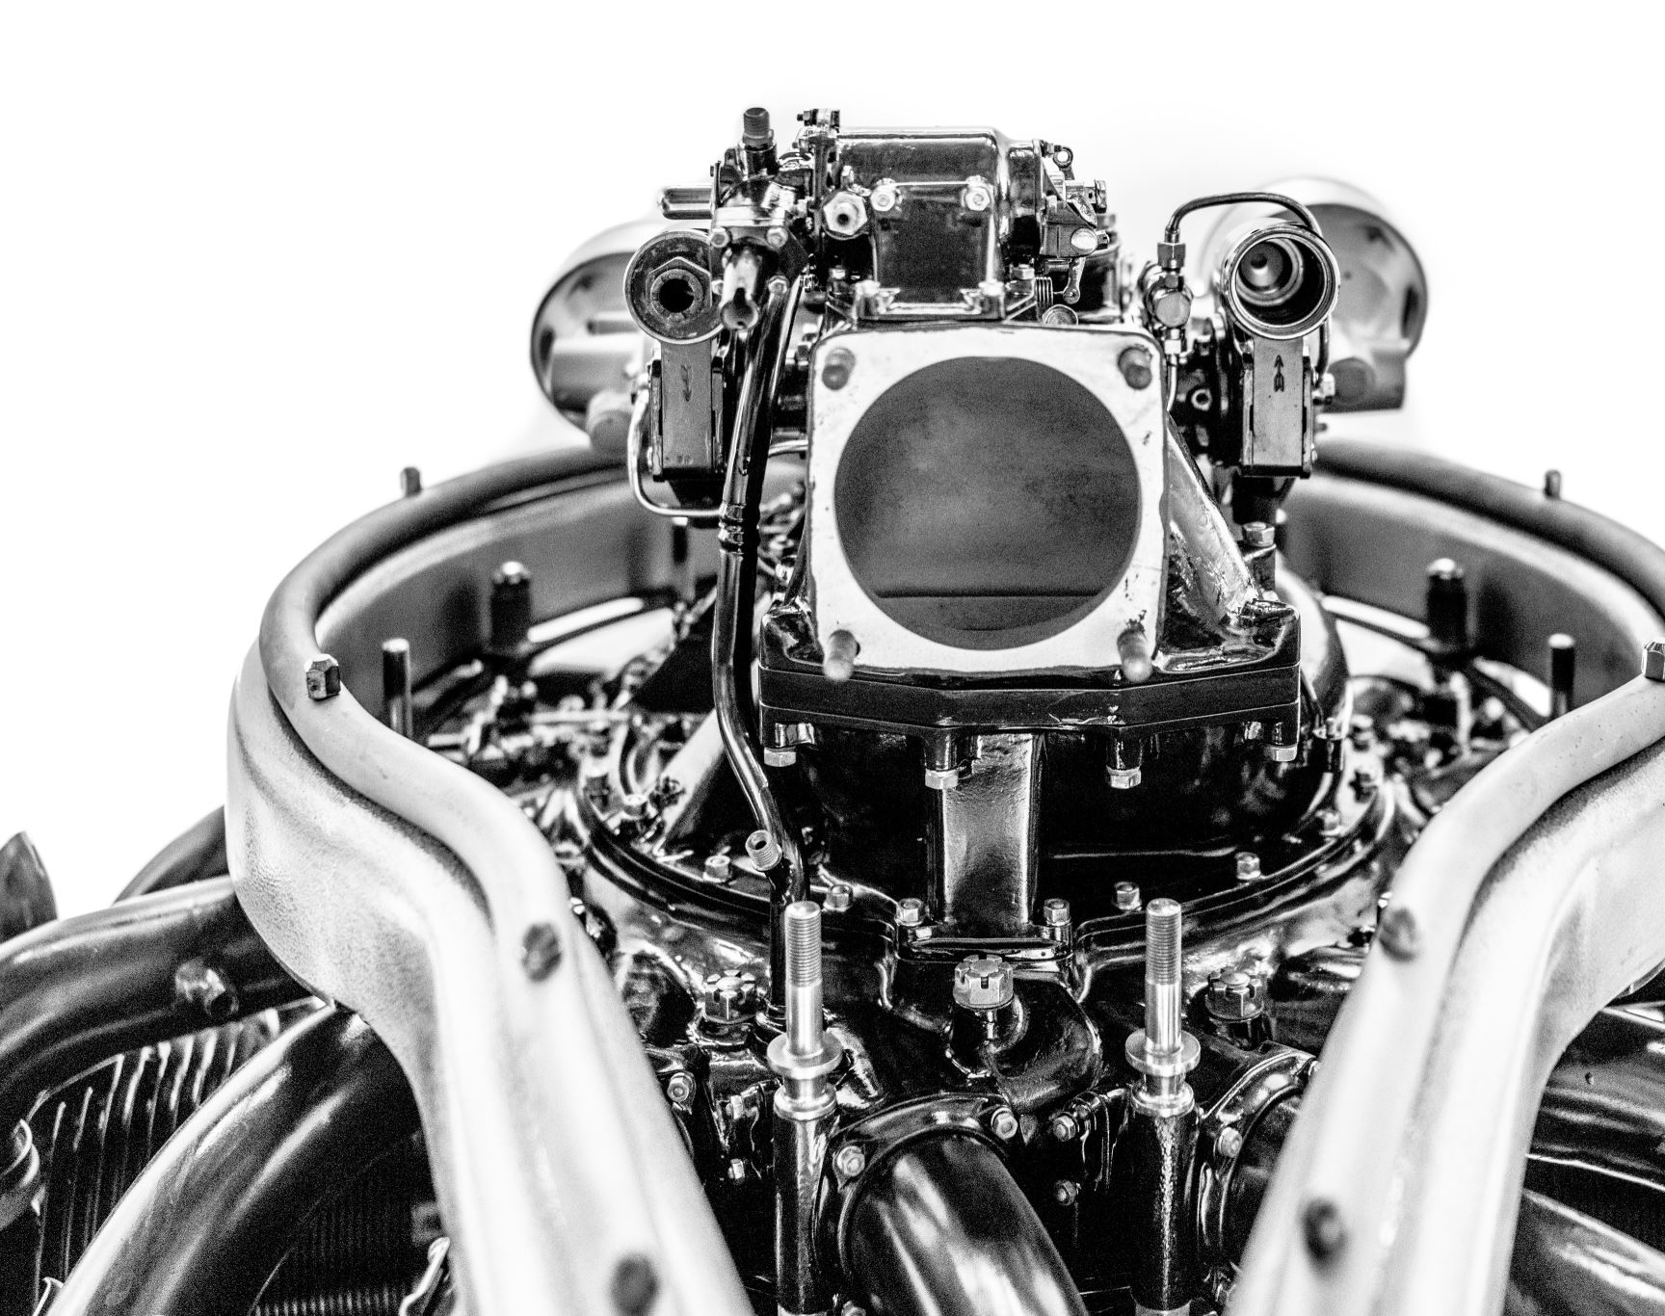
Engine Cylinders Analysis
Understanding the relationship between the Engine Cylinders and Popularity and identifying the popular Engine Cylinders.

Slide 14
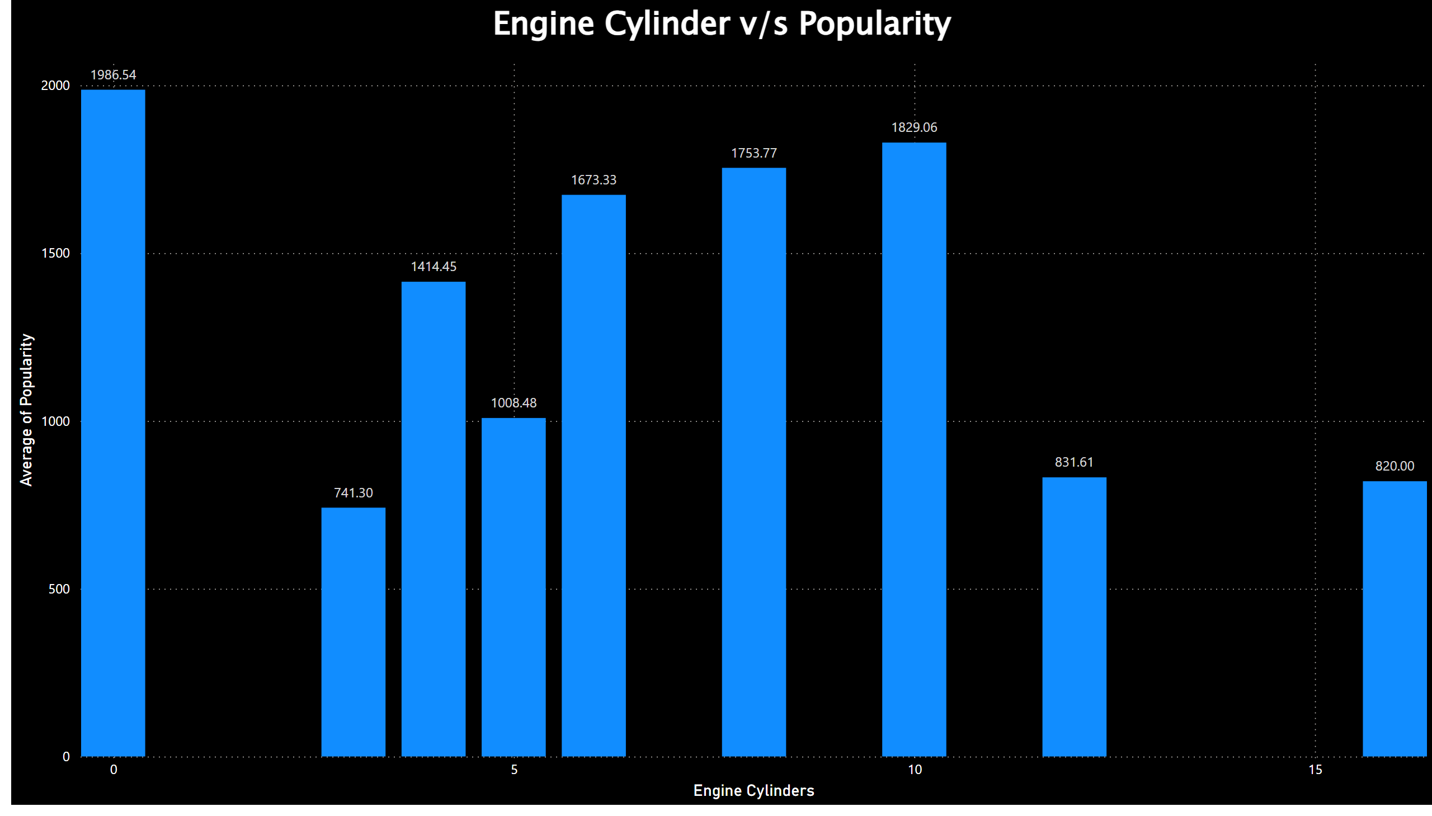
Engine Cylinder v/s Popularity
Notes:
Engine Cylinder v/s Popularity
No alt text provided

Slide 15
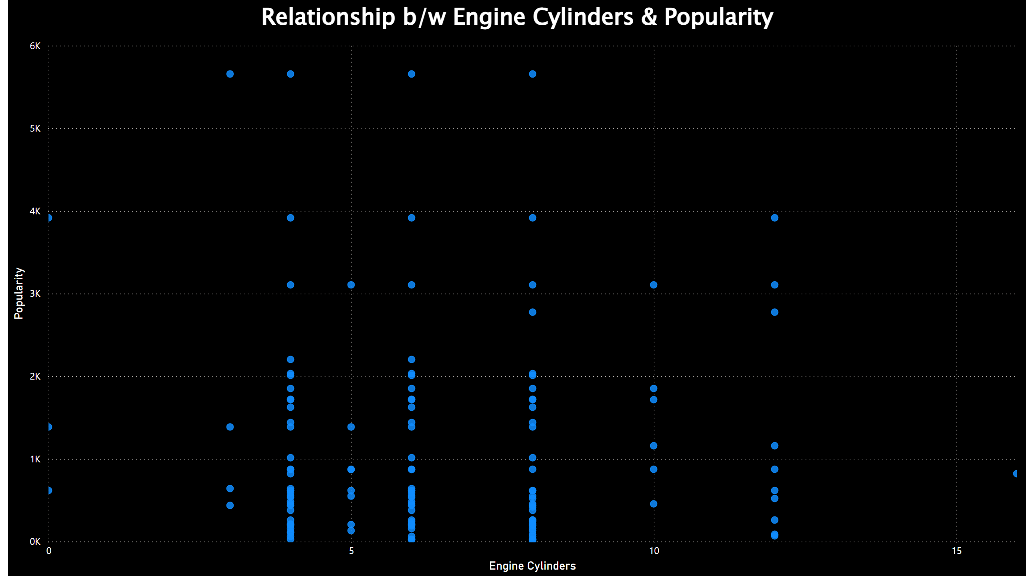
Relationship b/w Engine Cylinders & Popularity
Notes:
Relationship b/w Engine Cylinders & Popularity
No alt text provided

Slide 16
Insigths
Engine’s having 0 cylinders are the most popular, followed by engine’s with 10, 8, 6 cylinders respectively.
Also, there is no visible relationship between the Engine Cylinders and Popularity.

Slide 17

Transmission Type Analysis
Understanding the popularity of models based on transmission type

Slide 18
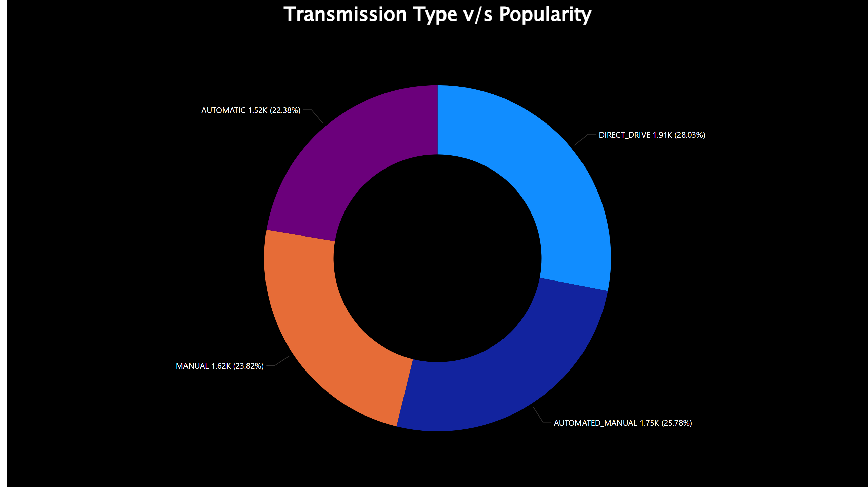
Transmission Type v/s Popularity
We can see that ‘DIRECT_DRIVE’ is the most popular transmission with mean popularity of 1.91K, followed by ‘AUTOMATED_MANNUAL’.
However, ‘AUTOMATIC’ is the least popular transmission type.
Notes:
Transmission Type v/s Popularity
No alt text provided

Slide 19

Driven Wheels Analysis
Understanding the popularity of models based on Driven Wheels

Slide 20
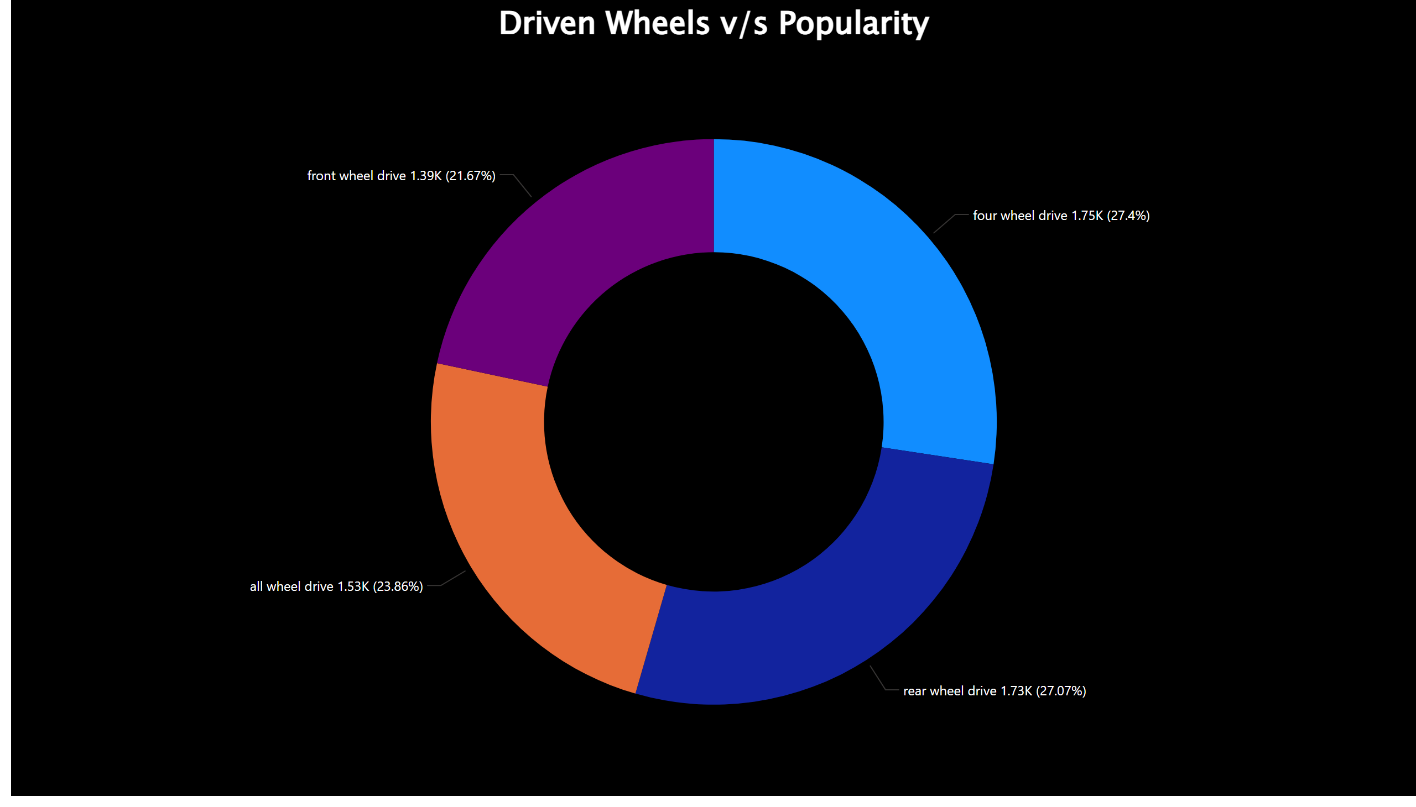
Driven Wheels v/s Popularity
We can see that, ‘four wheel drive’ is the most popular with mean popularity of 1.75K, followed by the ‘rear wheel drive’.
‘front wheel drive’, being the least popular with 1.39K as mean popularity.
Notes:
Driven Wheels v/s Popularity
No alt text provided

Slide 21
Number of Doors v/s Popularity
Understanding the relationship between number of doors and its popularity.

Slide 22
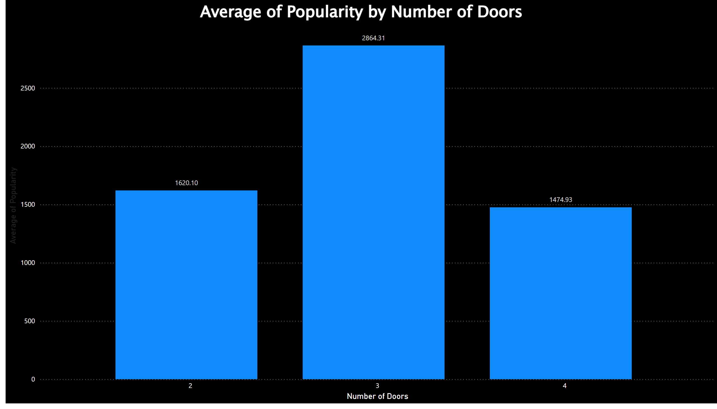
Average of Popularity by No. of Doors
We can see that vehicles with 3 doors are most popular than the vehicles with 2 and 4 doors.
Notes:
columnChart
No alt text provided

Slide 23
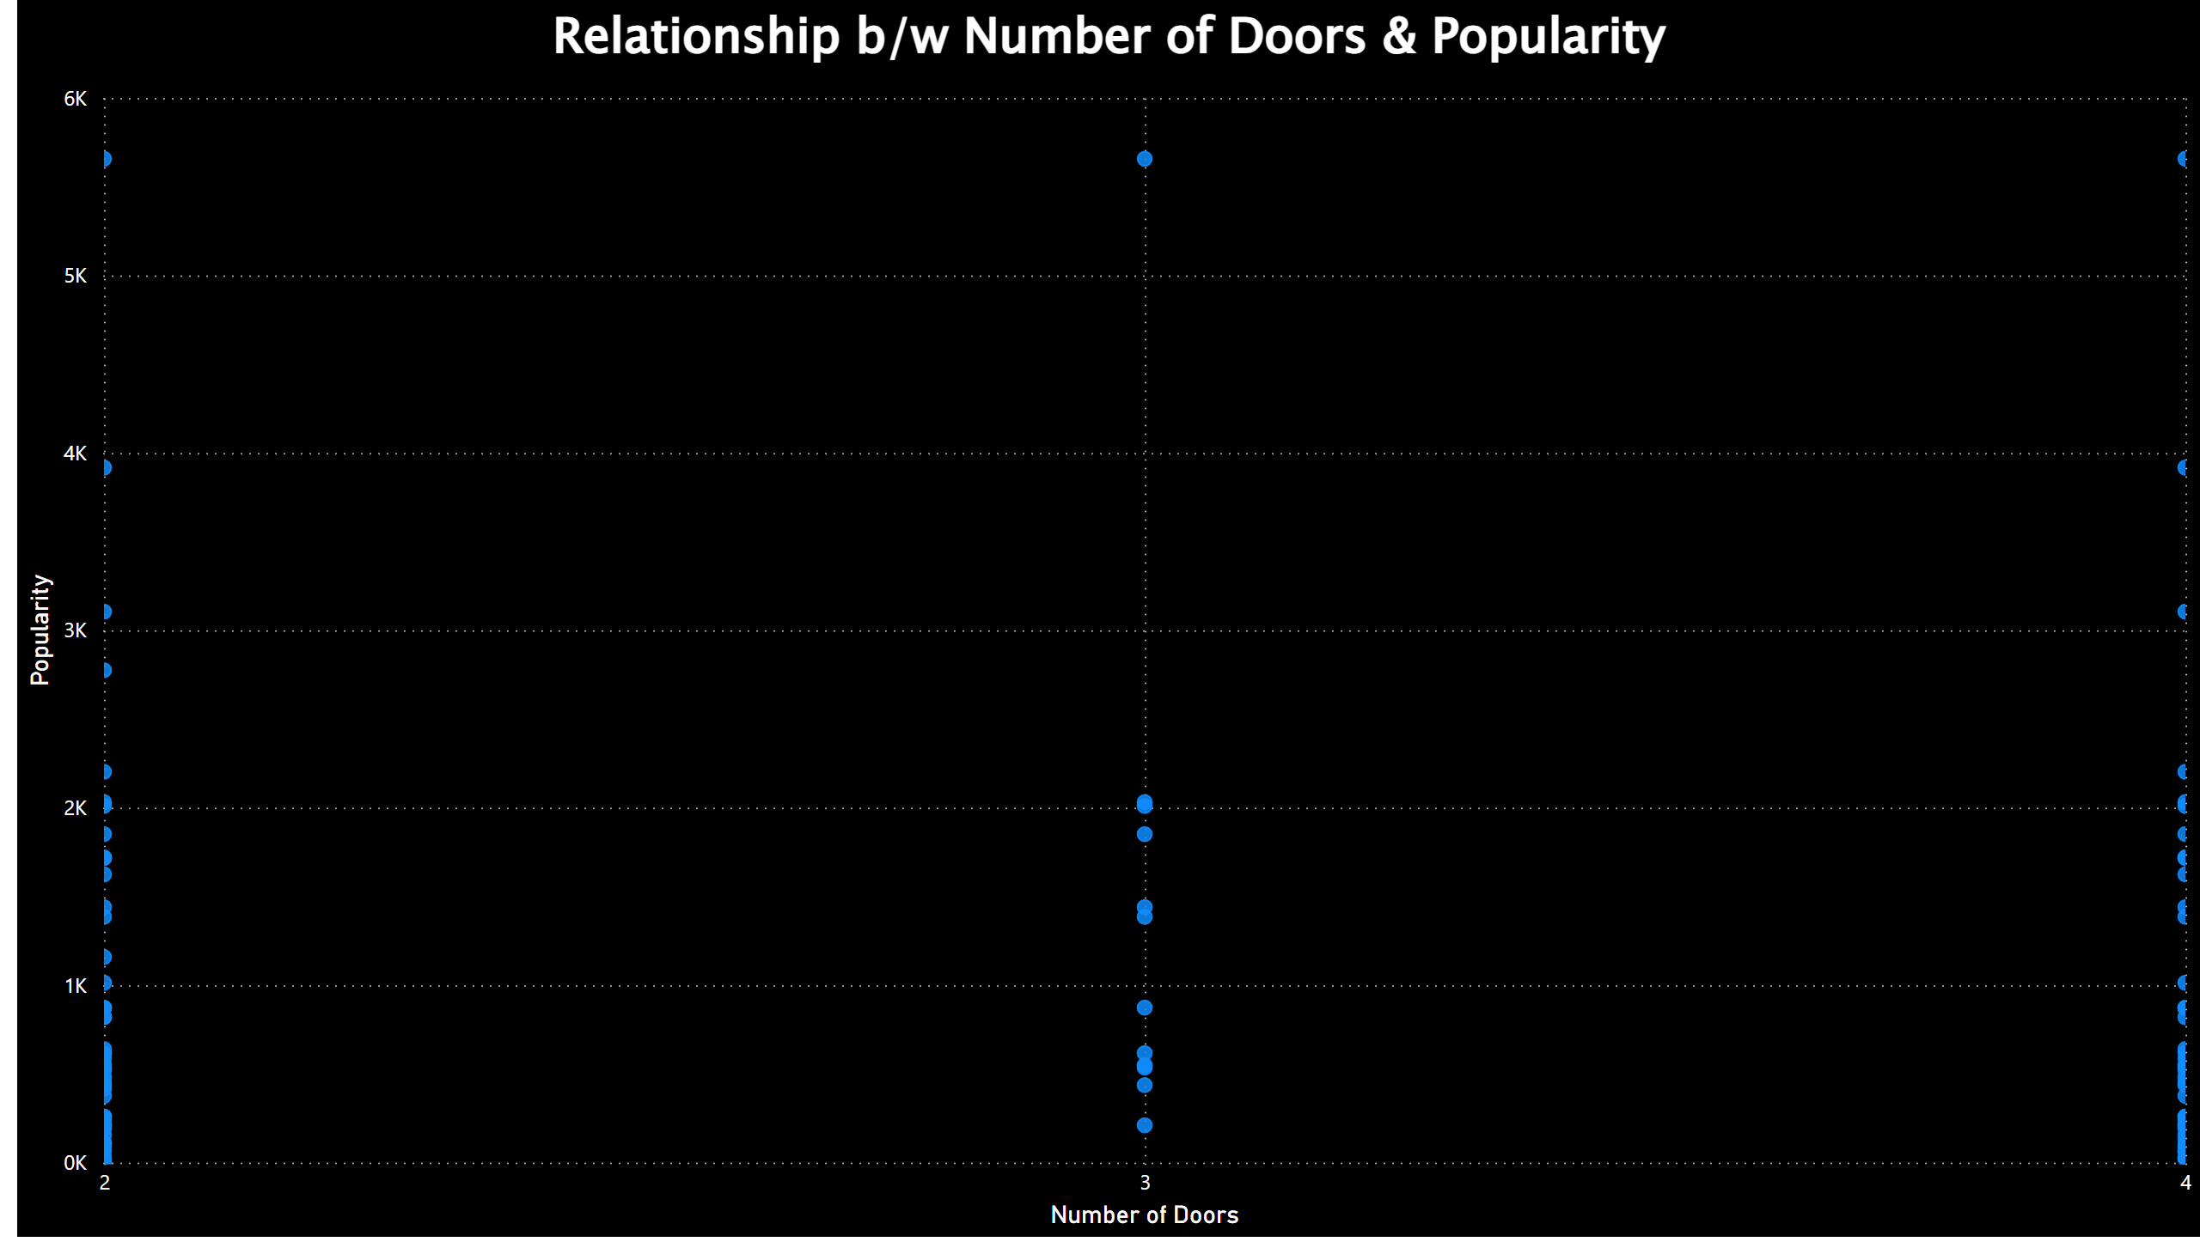
Relationship b/w Number of Doors & Popularity
There is no visible correlation between the Number of Doors and Popularity.
Notes:
Relationship b/w Number of Doors & Popularity
No alt text provided

Slide 24

Vehicle Analysis
Understanding the relationship between Vehicle Size, Vehicle Style and its popularity.

Slide 25
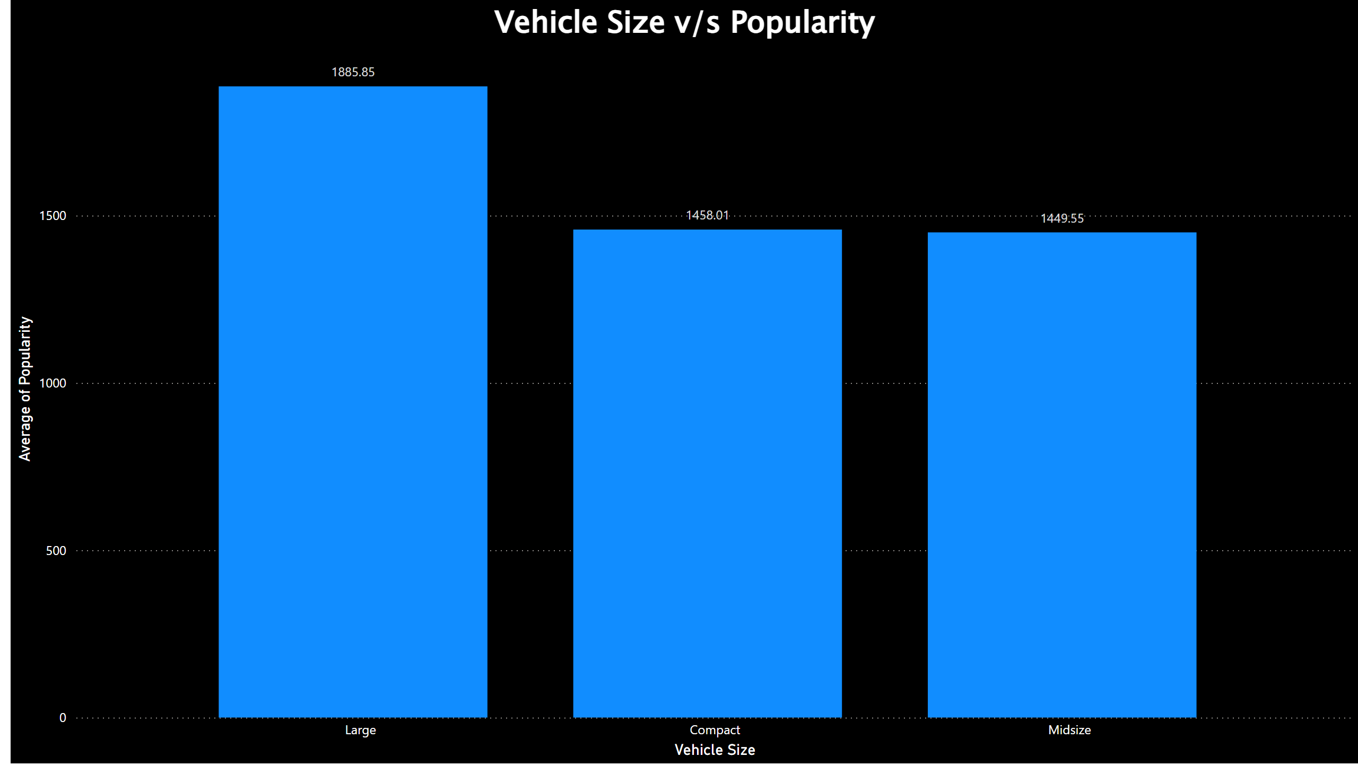
Vehicle Size v/s Popularity
It is clearly visible that the ‘large’ vehicles are the most preferred ones.
‘Compact’ and ‘ Midsize’ are having almost similar mean popularities.
Notes:
Vehicle Size v/s Popularity
No alt text provided

Slide 26
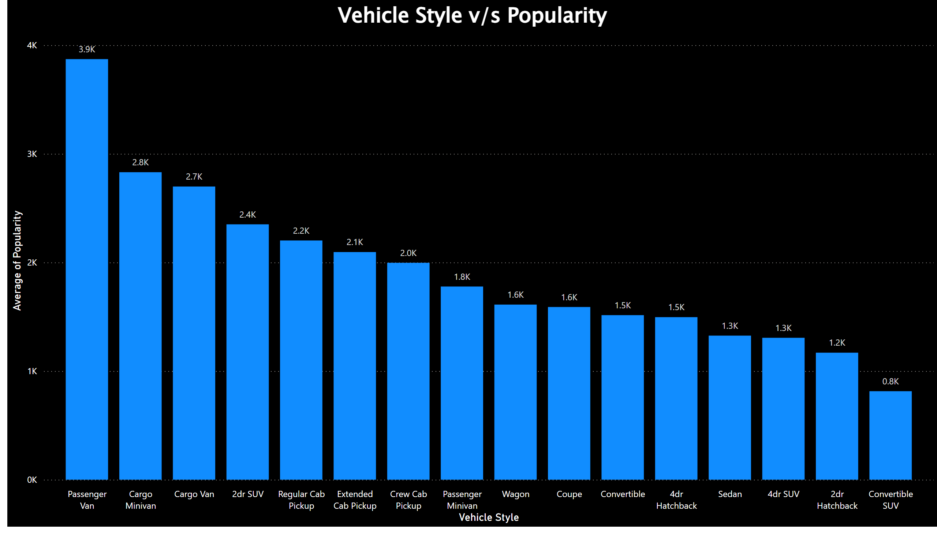
Vehicle Style v/s Popularity
‘Passenger Van’ are the most popular vehicle style, followed by ‘Cargo Minivan’.
‘Convertible SUV’ are the least popular vehicle style.
Notes:
Vehicle Style v/s Popularity
No alt text provided

Slide 27
Mileage Analysis
Understanding the relationship between vehicle mileage and its popularity.

Slide 28
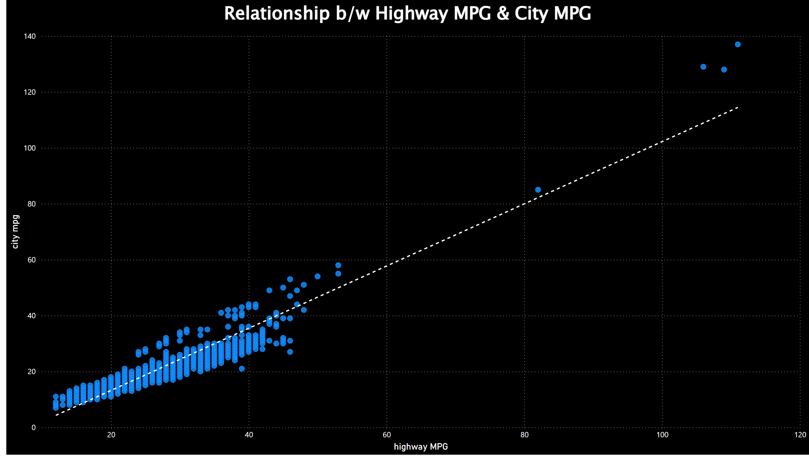
Relationship b/w Highway mpg & City mpg
We can see a positive correlation between the Highway MPG and City MPG, which indicates that, as the City MPG increases, Highway MPG also tends to increase.
Notes:
Relationship b/w Highway MPG & City MPG
No alt text provided

Slide 29
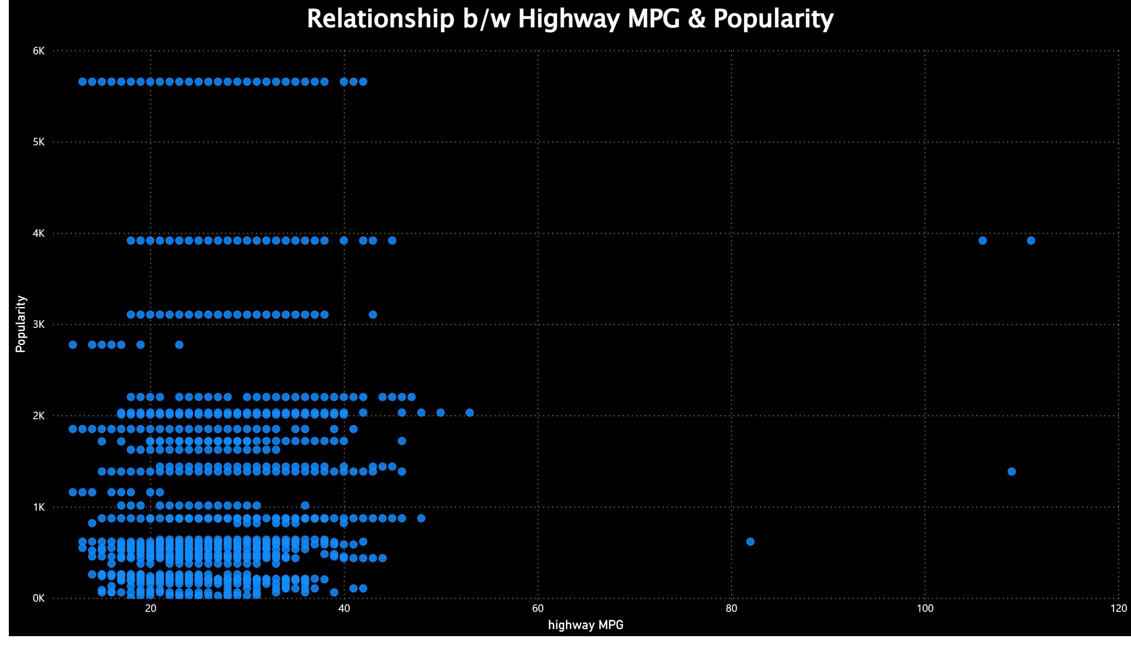
Relationship b/w Highway MPG & Popularity
However, there is no direct relationship is visible between the Highway MPG and Popularity.
Notes:
Relationship b/w Highway MPG & Popularity
No alt text provided

Slide 30
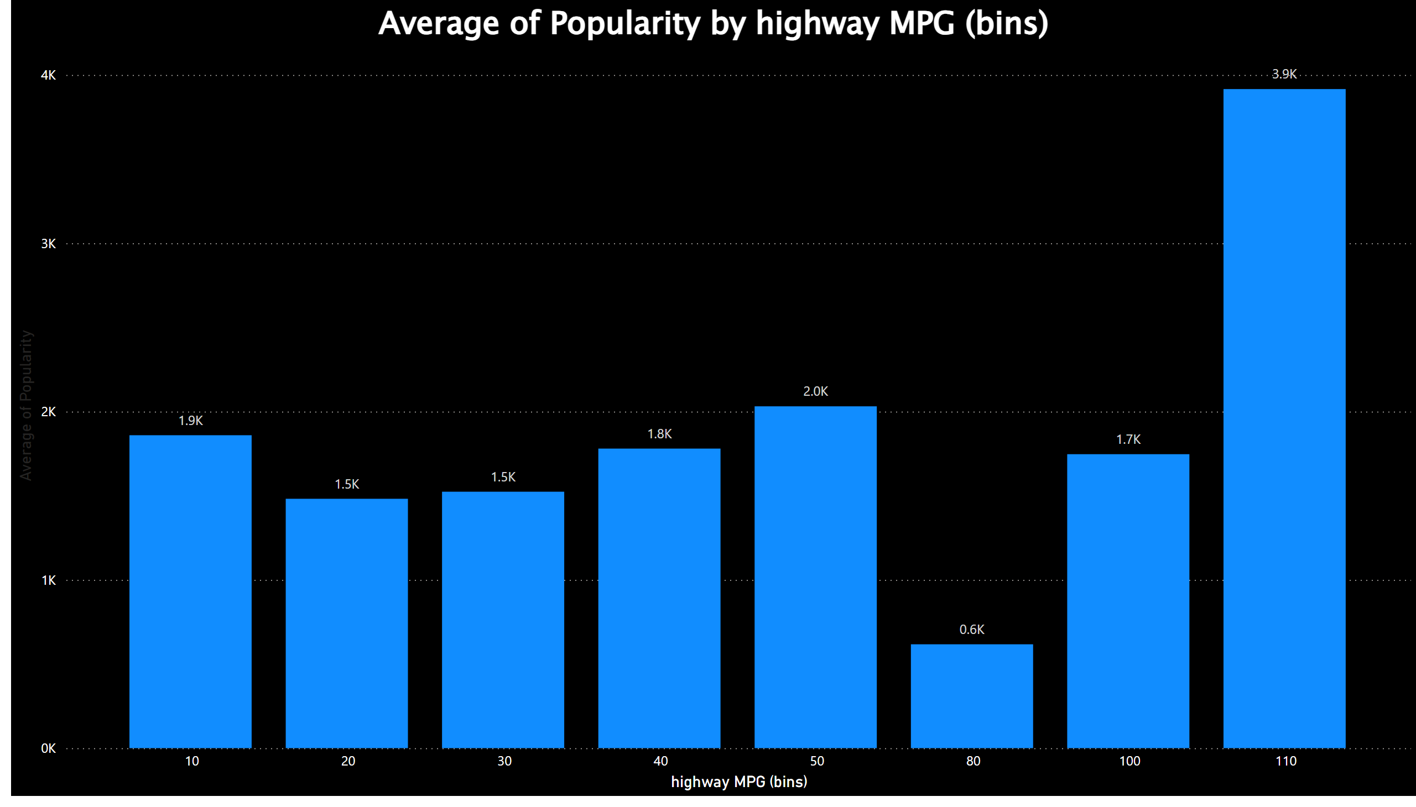
Average of Popularity by Highway MPG
It is clear that, High mileage providing vehicles are most popular.
Notes:
columnChart
No alt text provided

Slide 31
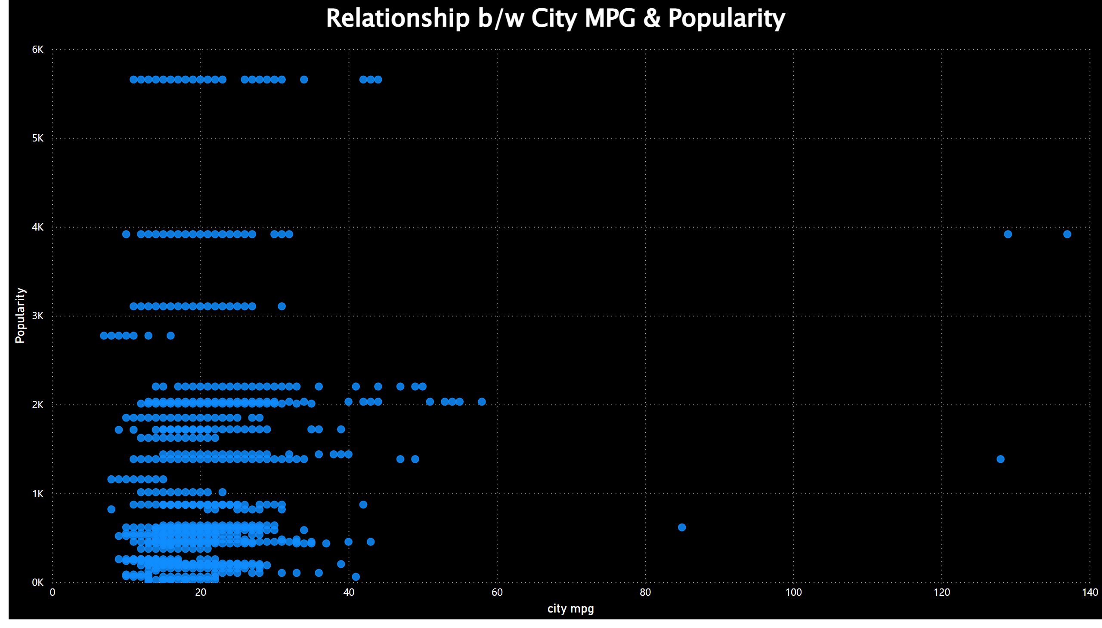
Relationship b/w City MPG & Popularity
Even in the case of City MPG also there is no direct relationship between the City MPG and Popularity.
Notes:
Relationship b/w City MPG & Popularity
No alt text provided

Slide 32
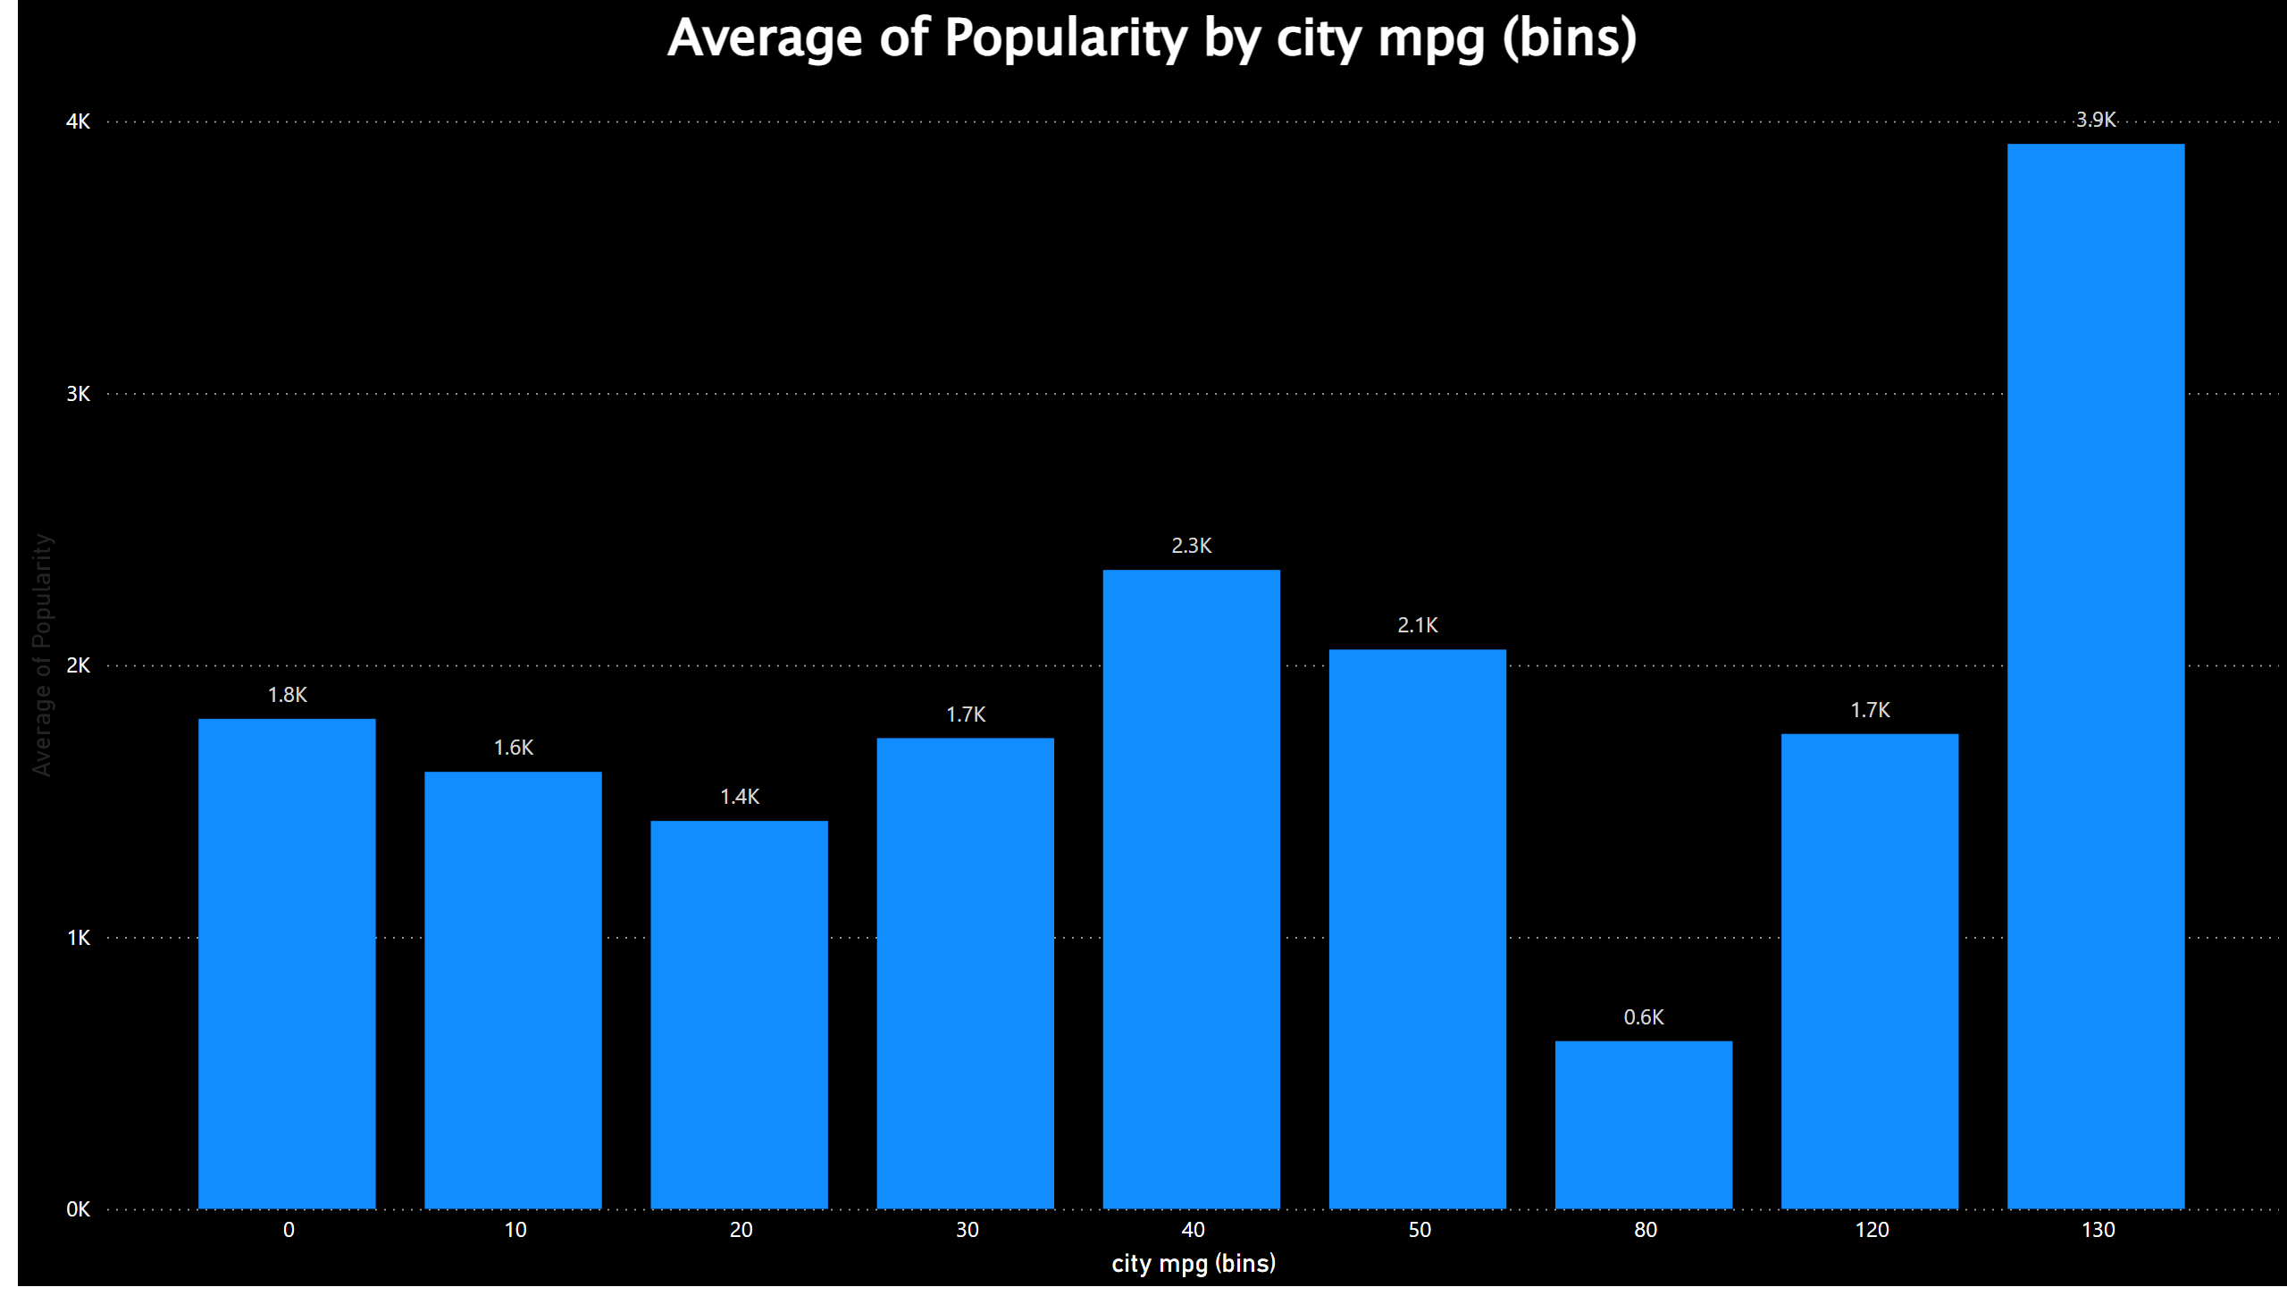
Average of Popularity by City MPG
It is clear that, even in the case of City MPG, high mileage providing vehicle is the popular one.
Interestingly, vehicles with City Mileage ranging from 40 to 50 are placed second.
Notes:
columnChart
No alt text provided

Slide 33

Price Analysis
Understanding the relationship between Price and Popularity.

Slide 34
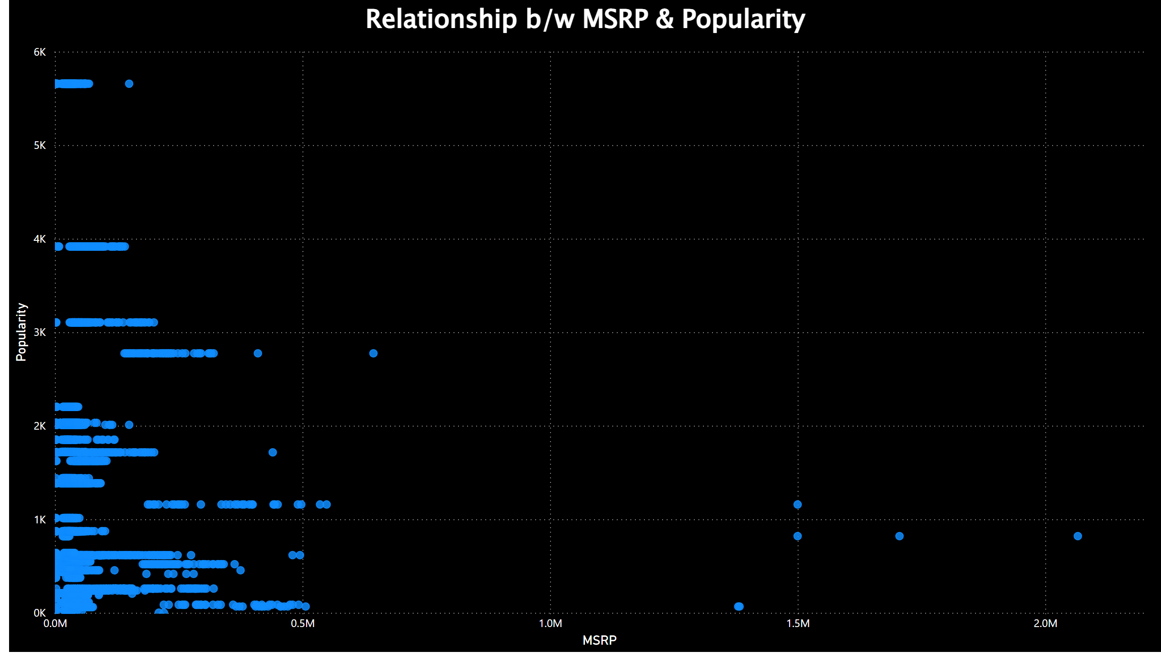
Relationship b/w MSRP & Popularity
Here, we can see that there is no direct correlation between Price and Popularity.
Notes:
Relationship b/w MSRP & Popularity
No alt text provided

Slide 35
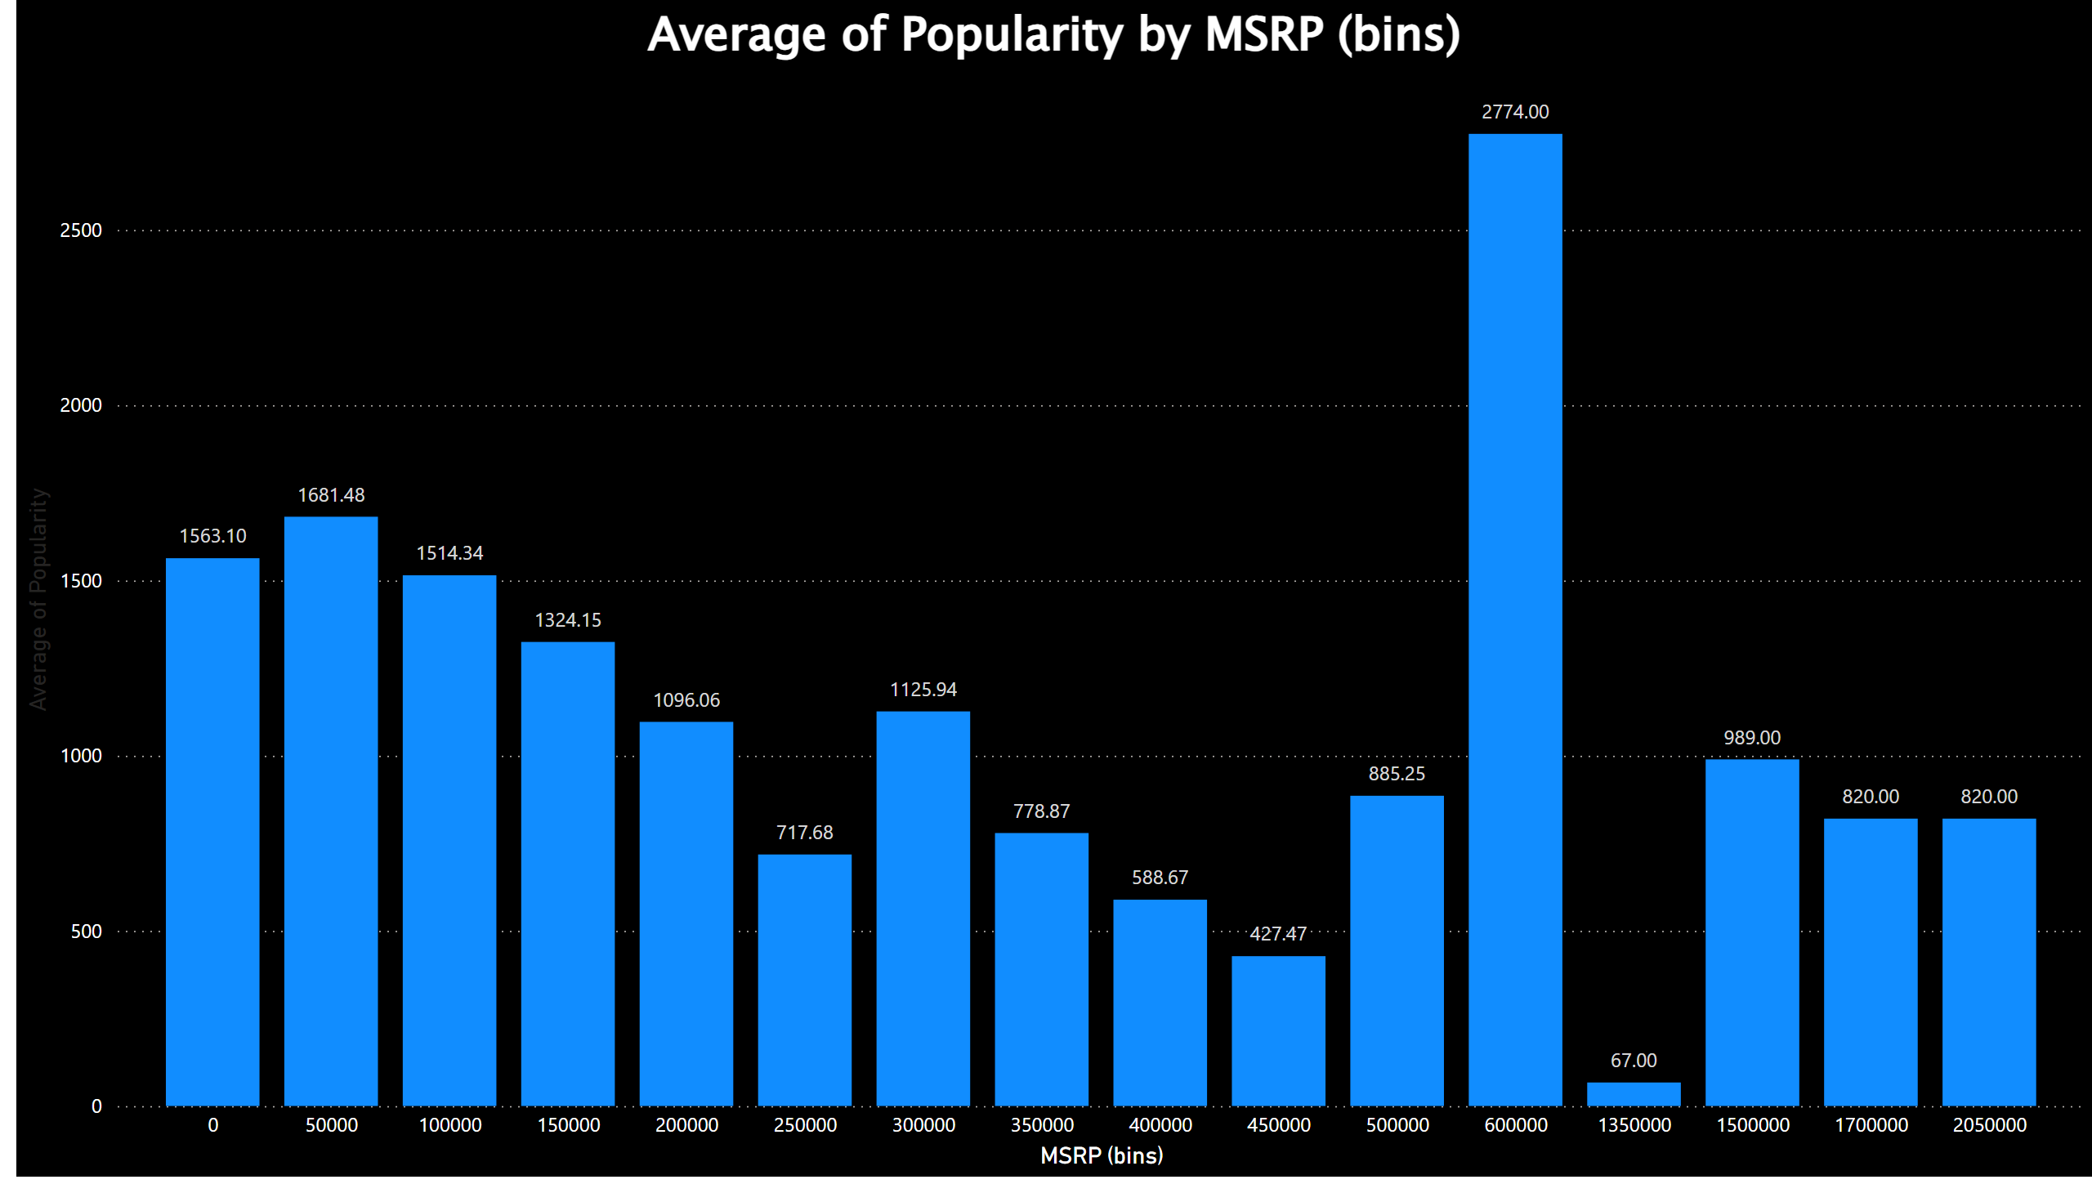
Average Popularity by MSRP (Bins)
The most popular Price range is between 6 Lakhs to 6.5 Lakhs.
Notes:
columnChart
No alt text provided

Slide 36

Market Category Analysis
Understanding the Popularity by Market Category

Slide 37
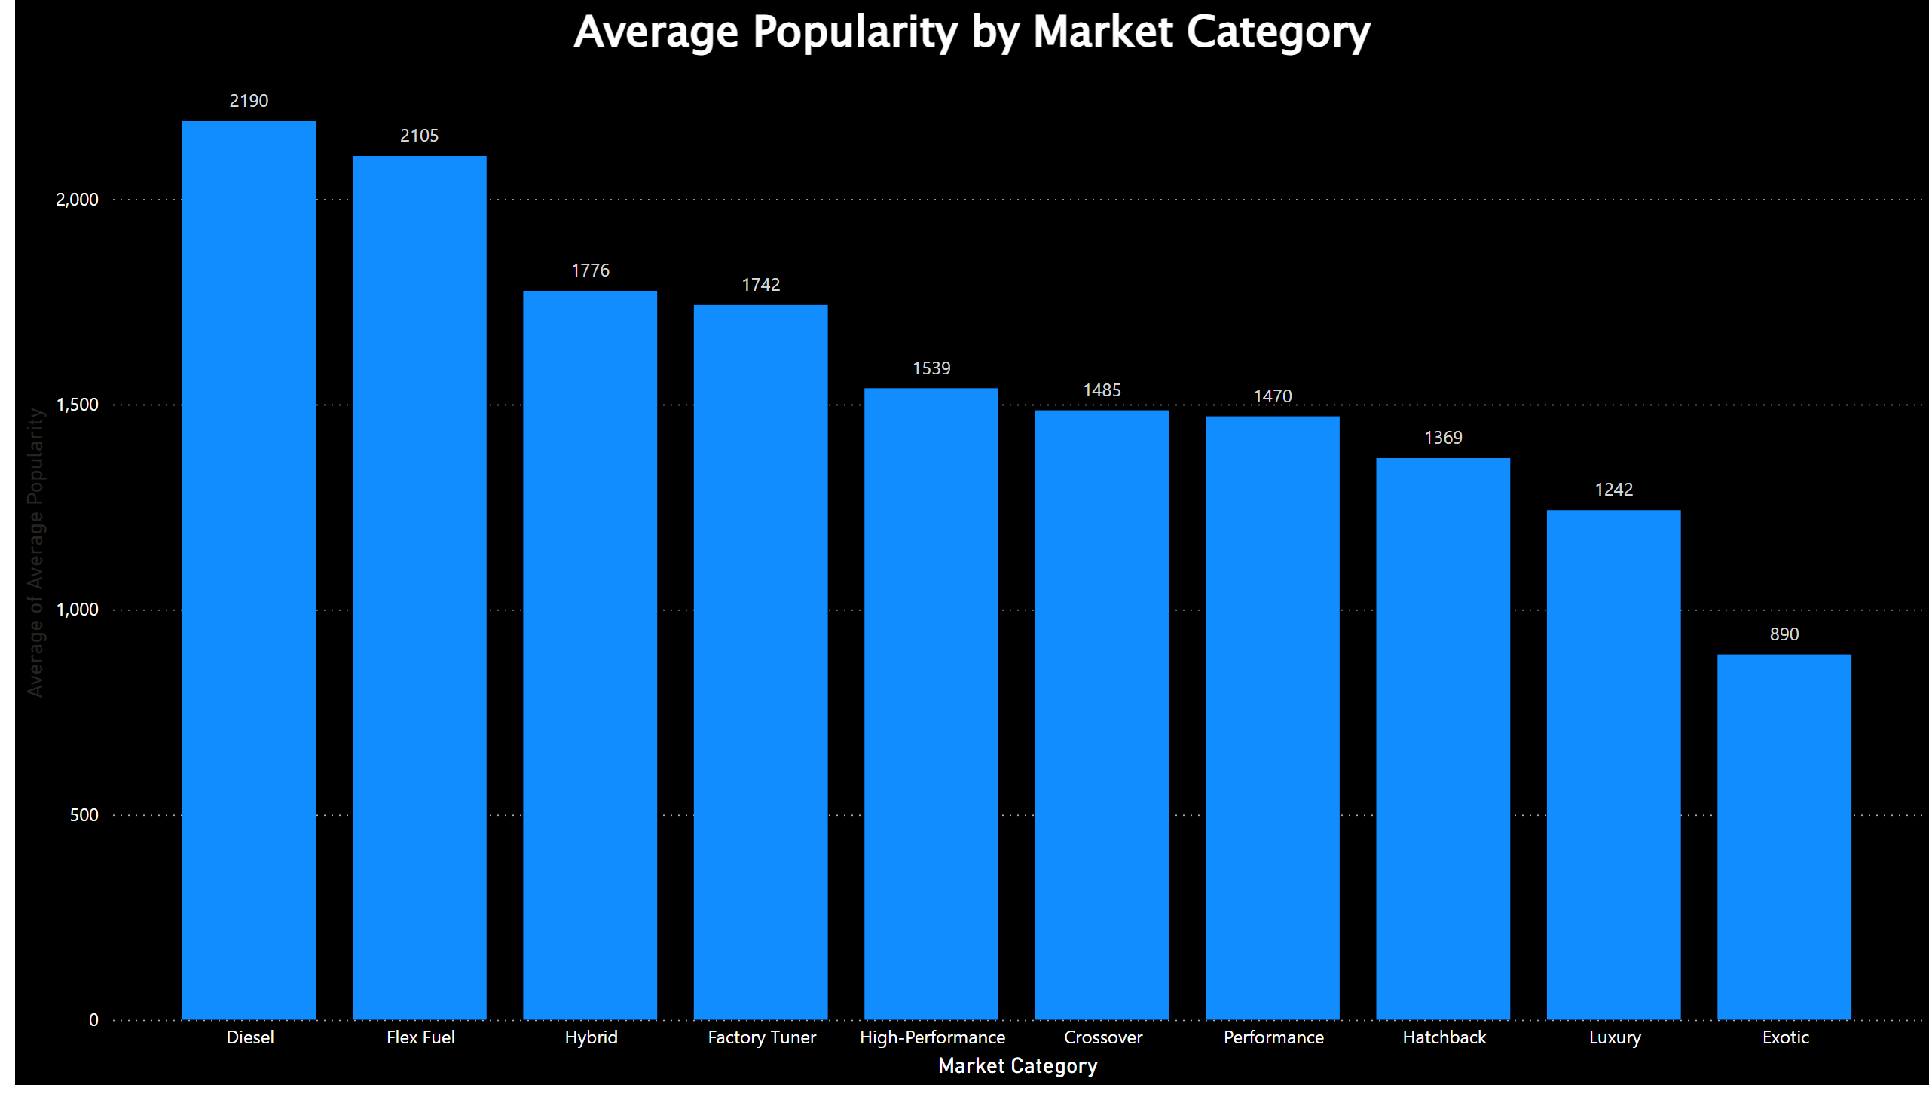
Average Popularity by Market Category
It is clear that, Market Category of ‘Diesel’ is the most popular category, followed by ‘Flex Fuel’.
‘Luxury’ and ‘Exotic’ are the least popular ones.
Notes:
Average Popularity by Market Category
No alt text provided

Slide 38
Thank You
Access the Excel workbook and the Power BI report related to this analysis from the below provided link.
Microsoft Excel
Microsoft Power BI

